Slide 1

Optimization of live multiple vm migration
Prasad P. Netalkar
ECE 509: Convex Optimization: Final Project Presentation
Notes:
NOTE:
To change the image on this slide, select the picture and delete it. Then click the Pictures icon in the placeholder to insert your own image.

Slide 2
Overview
Cloud/Data center and Virtual Machine (VM) basics
VM Migration Algorithm: Pre Copy
Problem Statement
Mathematical Model Formulation
Geometric Programming Approach for Optimization
Result
Conclusion
References

Slide 3
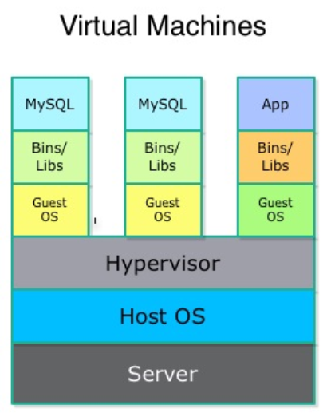
Data Center and VM Basics
Cloud is nothing but a datacentre which provides basic services like-
Computing
Storage
Data centre is a collection of these storage and compute resources distributed throughout the world by cloud provides like AWS and Microsoft.
These resources can be accessed from anywhere through Internet.
VM is a shared instance of physical resources providing the same set of services and are allocated on-demand to users.
Efficient resource sharing
Full control
VM1
VM2
VM3

Slide 4
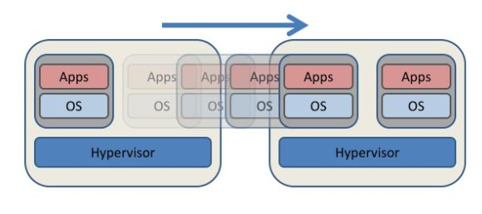
Virtual Machine (VM) Migration- A Very Known Problem
VM Migration occur due to :
Change in resource demands
Change in user location
Providing seamless migration with low downtime is very challenging
Pre-copy: widely used algorithm for VM migration
Iterative algorithm with 3 steps:
Static memory copy phase
Dirty memory copy phase (new changes to memory)
Stop and copy phase
Migration
SRC
DST

Slide 5
Problem Statement
Pre copy algorithm takes care of migration (3 steps):
If nj is considered as total number of rounds-
Static memory copy phase (round 0)
Dirty memory copy phase (round 1 to nj-1): Iterative
Stop and copy phase (round nj)
Migrating multiple VMs simultaneously is very challenging and it depends on :
Bandwidth availability
VM Memory Size & Dirty Rate
Problem: Allocating optimal BW/Rate between various VM’s and also on deciding the optimal number of rounds required such that total time for migration is minimised.
VM migration
VM
BW
VM
SRC
DST
High Level Concept Diagram

Slide 6
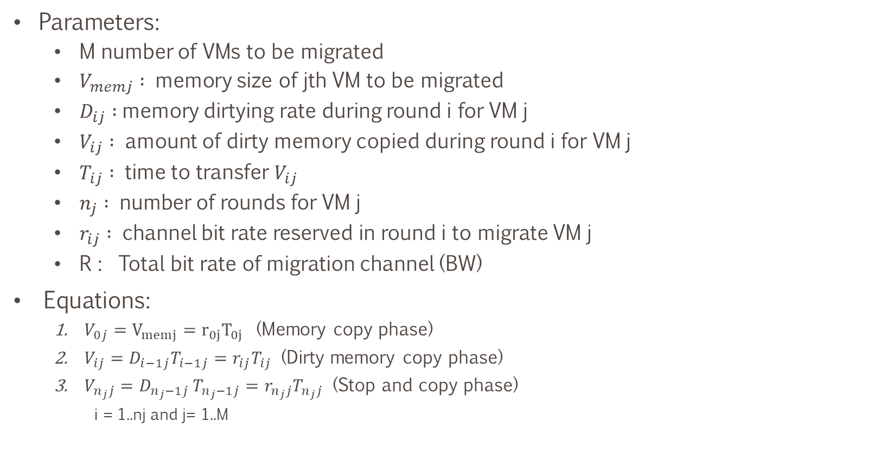
Problem Formulation:
Parameters:
M number of VMs to be migrated
$V_{memj} :$ memory size of jth VM to be migrated
$D_{ij} :$memory dirtying rate during round i for VM j
$V_{ij} :$ amount of dirty memory copied during round i for VM j
$T_{ij} :$ time to transfer $V_{ij}$
$n_{j} :$ number of rounds for VM j
$r_{ij} :$ channel bit rate reserved in round i to migrate VM j
R : Total bit rate of migration channel (BW)
Equations:
$V_{0j}=V_{memj}=r_{0j}T_{0j}$ (Memory copy phase)
$V_{ij}=D_{i−1j}T_{i−1j}=r_{ij}T_{ij}$ (Dirty memory copy phase)
$V_{n_{j}j}=D_{n_{j}−1j }T_{n_{j}−1j}=r_{n_{j}j}T_{n_{j}j}$ (Stop and copy phase)
i = 1..nj and j= 1..M

Slide 7

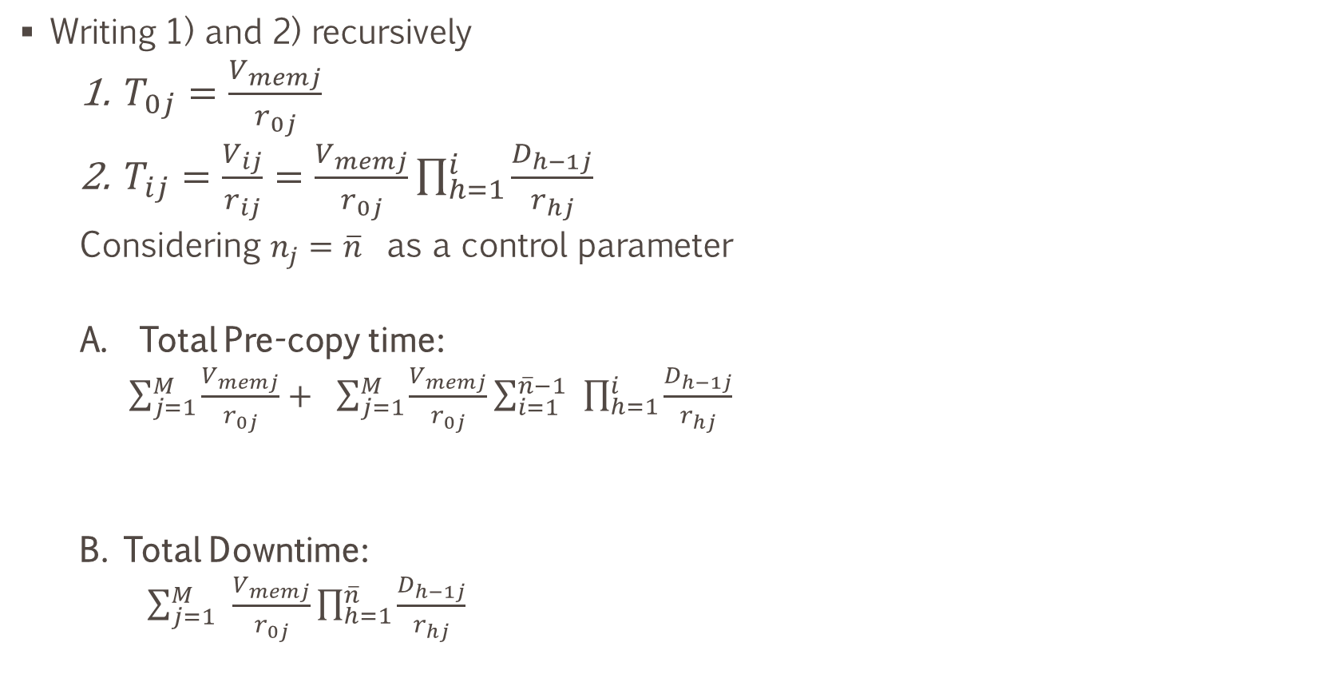

Problem Formulation:
Writing 1) and 2) recursively
$T_{0j}=\frac{V_{memj}}{r_{0j}}$
$T_{ij}=\frac{V_{ij}}{r_{ij}}=\frac{V_{memj}}{r_{0j}}\prod_{h=1}^{i}{\frac{D_{h−1j}}{r_{hj}}}$
Considering $n_{j}=\overline{n}$ as a control parameter
Total Pre-copy time:
$\sum_{j=1}^{M}{\frac{V_{memj}}{r_{0j}}+ }$ $\sum_{j=1}^{M}{\frac{V_{memj}}{r_{0j}}\sum_{i=1}^{\overline{n}−1}{ }\prod_{h=1}^{i}{\frac{D_{h−1j}}{r_{hj}}}}$
B. Total Downtime:
$\sum_{j=1}^{M}{ }\frac{V_{memj}}{r_{0j}}\prod_{h=1}^{\overline{n}}{\frac{D_{h−1j}}{r_{hj}}}$
Round 0
Round 1 .. $\overline{n}$-1
Round $\overline{n}$

Slide 8
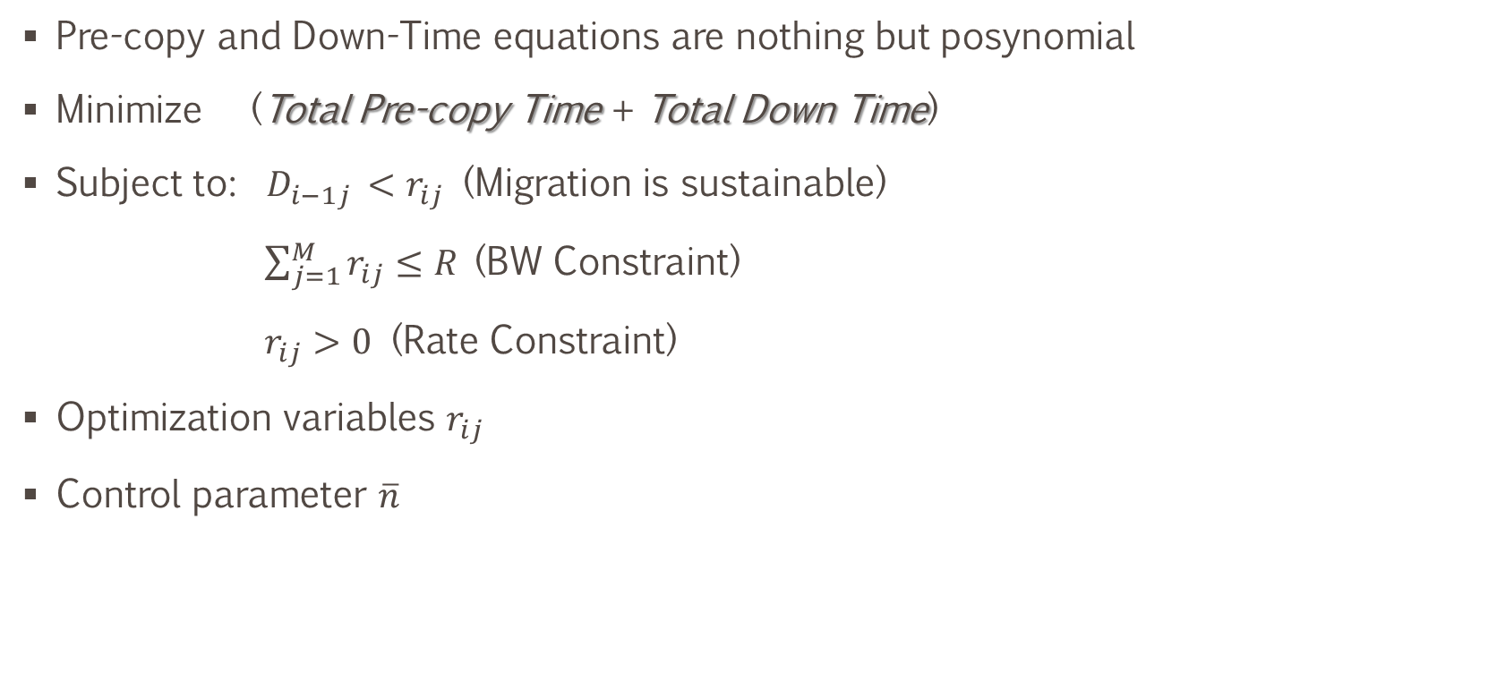
Geometric Programming Approach
Pre-copy and Down-Time equations are nothing but posynomial
Minimize (Total Pre-copy Time + Total Down Time)
Subject to: $D_{i−1j }<r_{ij}$ (Migration is sustainable)
$\sum_{j=1}^{M}{r_{ij}≤R}$(BW Constraint)
$r_{ij}>0$ (Rate Constraint)
Optimization variables $r_{ij}$
Control parameter $\overline{n}$

Slide 9
Results
MATLAB GPSOLVER
Perturbed Problem
10 trails &
Avg VM size 1000 MB
VM Size (MB): 177.10 ; 662.80 ; 330.8
Rate (MB/s): 31.78 ; 53.04 ; 40.16
VM Size (MB): 177.10 ; 662.80 ; 330.8
Rate (MB/s): 16.72 ; 25.46 ; 20.30

Slide 10
Conclusion
A overview of precopy algorithm and problem pertaining to VM migration was provided.
GP convex solver is used to get the optimum number of rounds and bit rate between VMs such that total time for migration is minimised.
Some observation:
Fewer number of rounds are enough as the total time saturates after some time.
If the BW is too low, its always better to migrate as early as possible.

Slide 11
References
1) Cerroni, Walter, and Flavio Esposito. "Optimizing live migration of multiple virtual machines." IEEE Transactions on Cloud Computing (2016).*
2) Liu, Haikun, et al. "Performance and energy modeling for live migration of virtual machines." Proceedings of the 20th international symposium on High performance distributed computing. ACM, 2011
3) Boyd, Stephen, et al. "A tutorial on geometric programming." Optimization and engineering 8.1 (2007): 67
*(main)

